Slide 1
Formic acid fuel cell catalyst
Marcus Nørgaard Weng, Nanoscience MSc student, CHEAC, Jan Rossmeisl group

Slide 2
Table of contents
Power-to-X
Formic acid (Compared to hydrogen)
Reaction pathways
DFT data (new)
Activity estimation

Slide 3
Reaction pathways
Figure source: Bagger, Alexander, et al. "Correlations between experiments and simulations for formic acid oxidation." Chemical Science 13.45 (2022): 13409-13417.

Slide 4
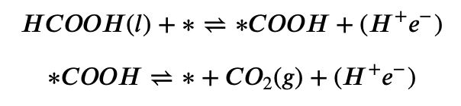
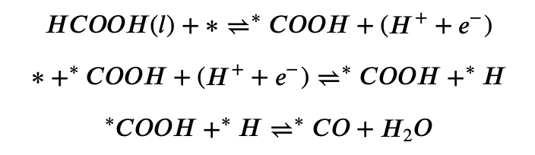
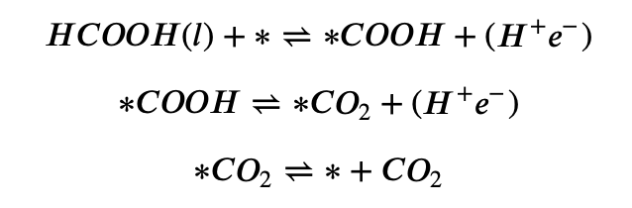
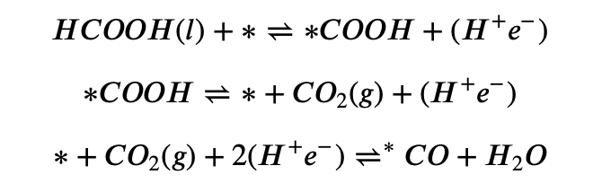
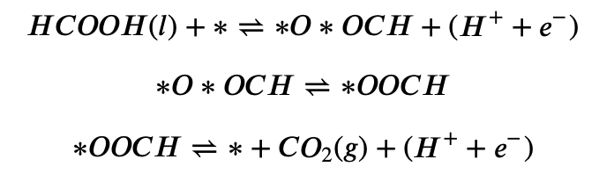
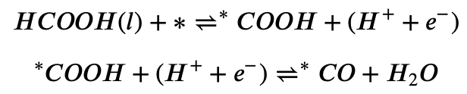
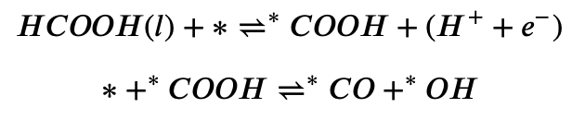
Reaction pathways
Favourable reactions:
Unfavourable reactions:

Slide 5
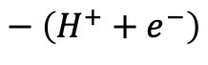
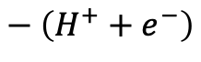
Reaction pathways
Favourable reactions:
H
O
-
=
O
-
C
-
H
H
O
$$− \left(H^{+}+e^{−}\right)$$
-
=
O
-
C
-
O
O
$$− \left(H^{+}+e^{−}\right)$$
=
=
C

Slide 6
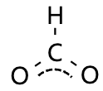
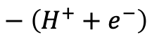
Reaction pathways
Favourable reactions:
H
O
-
=
O
-
C
-
H
H
$$− \left(H^{+}+e^{−}\right)$$
-
C
-
-
O
O
-
-
-
O
=
$$− \left(H^{+}+e^{−}\right)$$
C
=
O

Slide 7
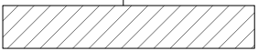
H
O
H
O
-
=
-
=
O
-
C
O
-
-
C
H
-
H
H
O
-
=
O
C

Slide 8
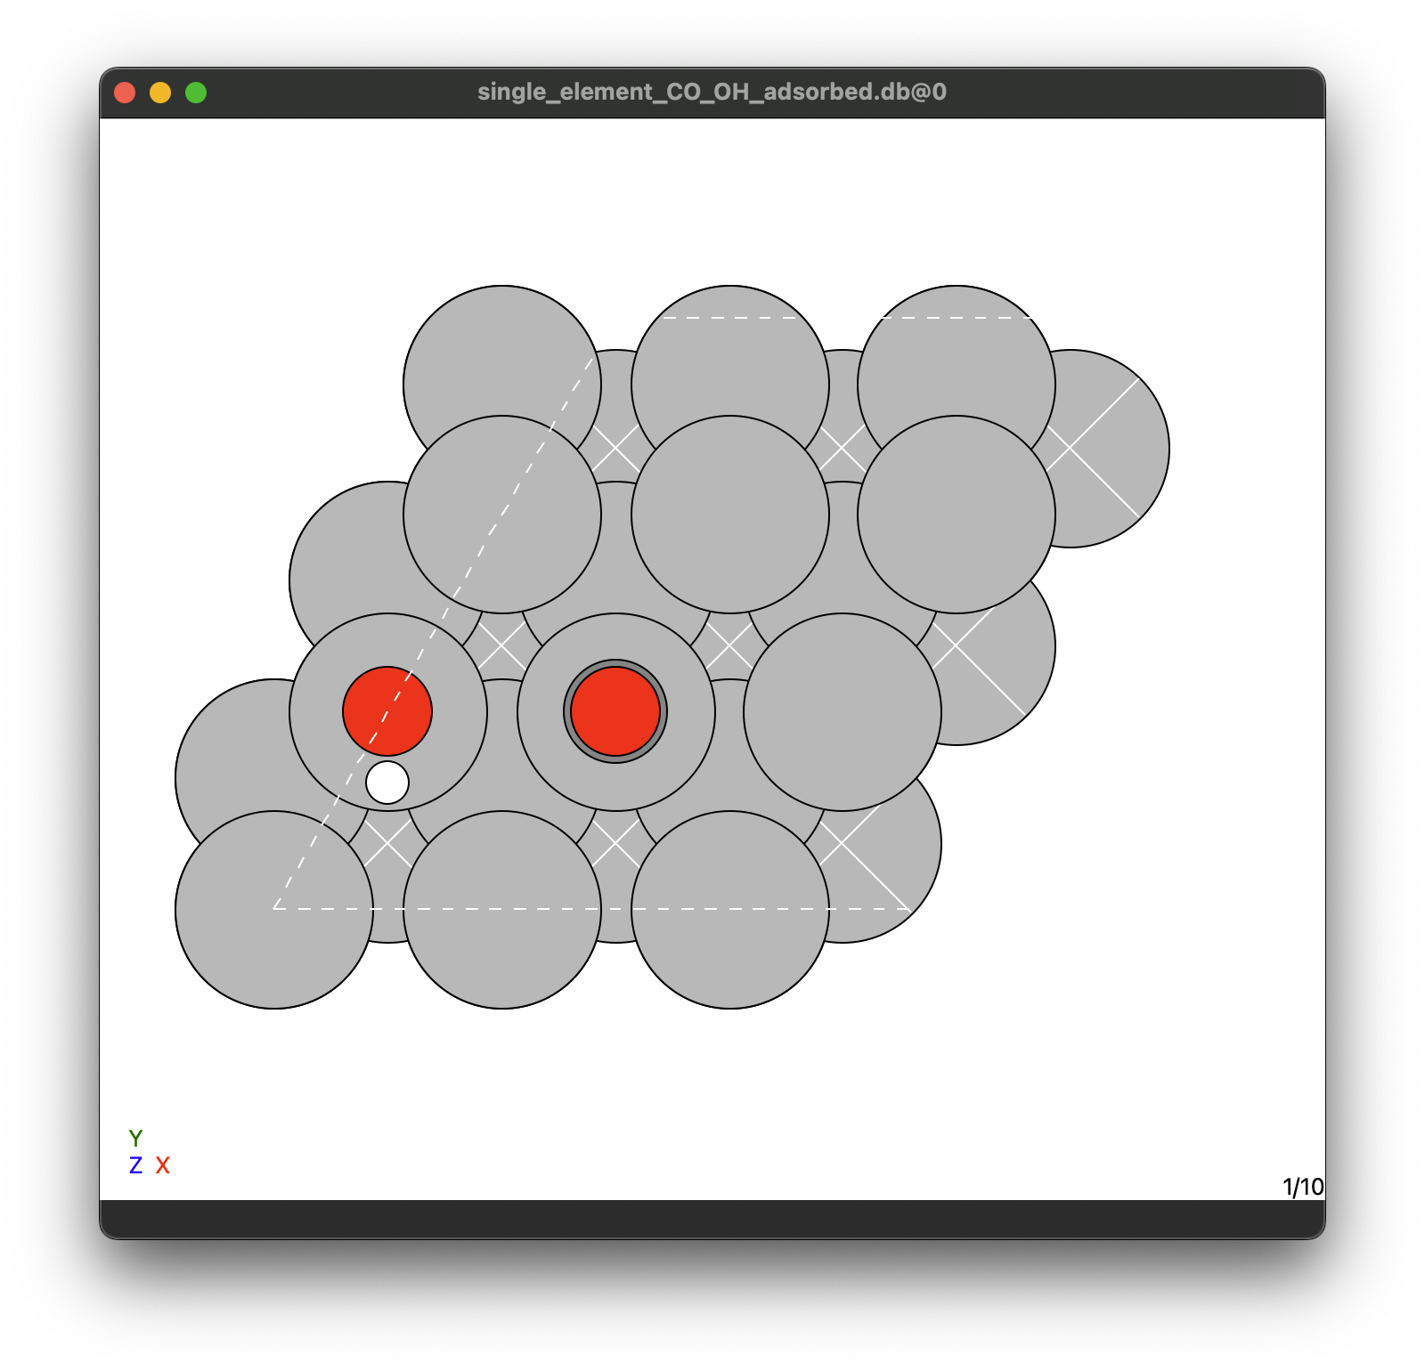
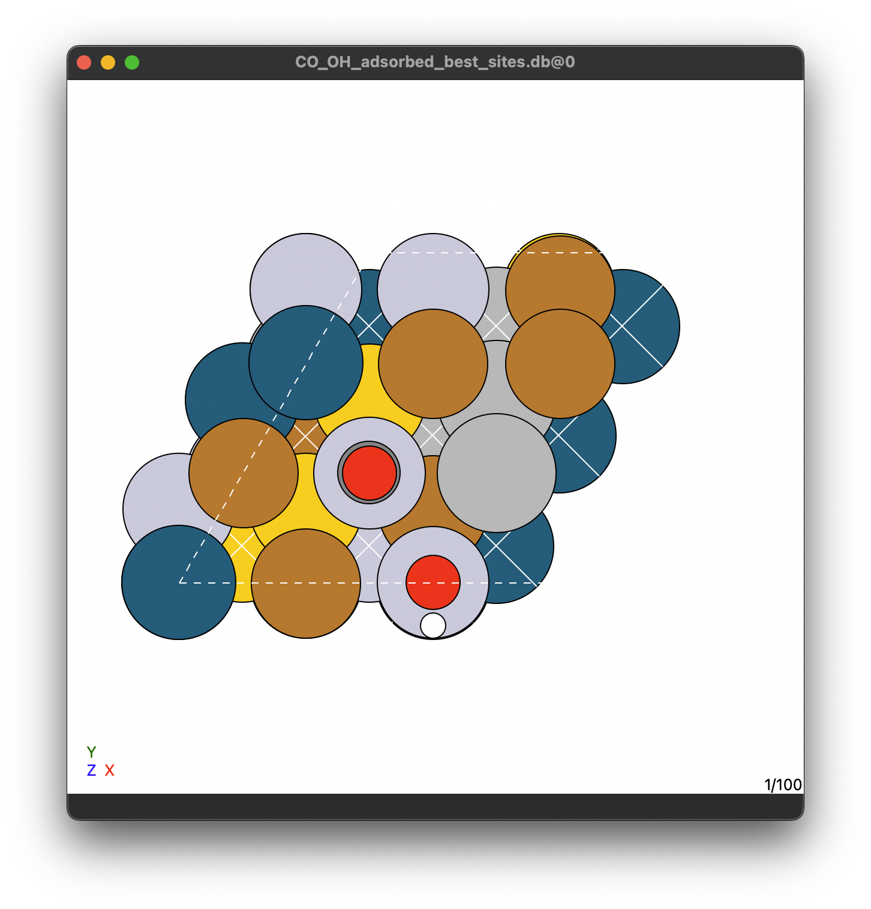
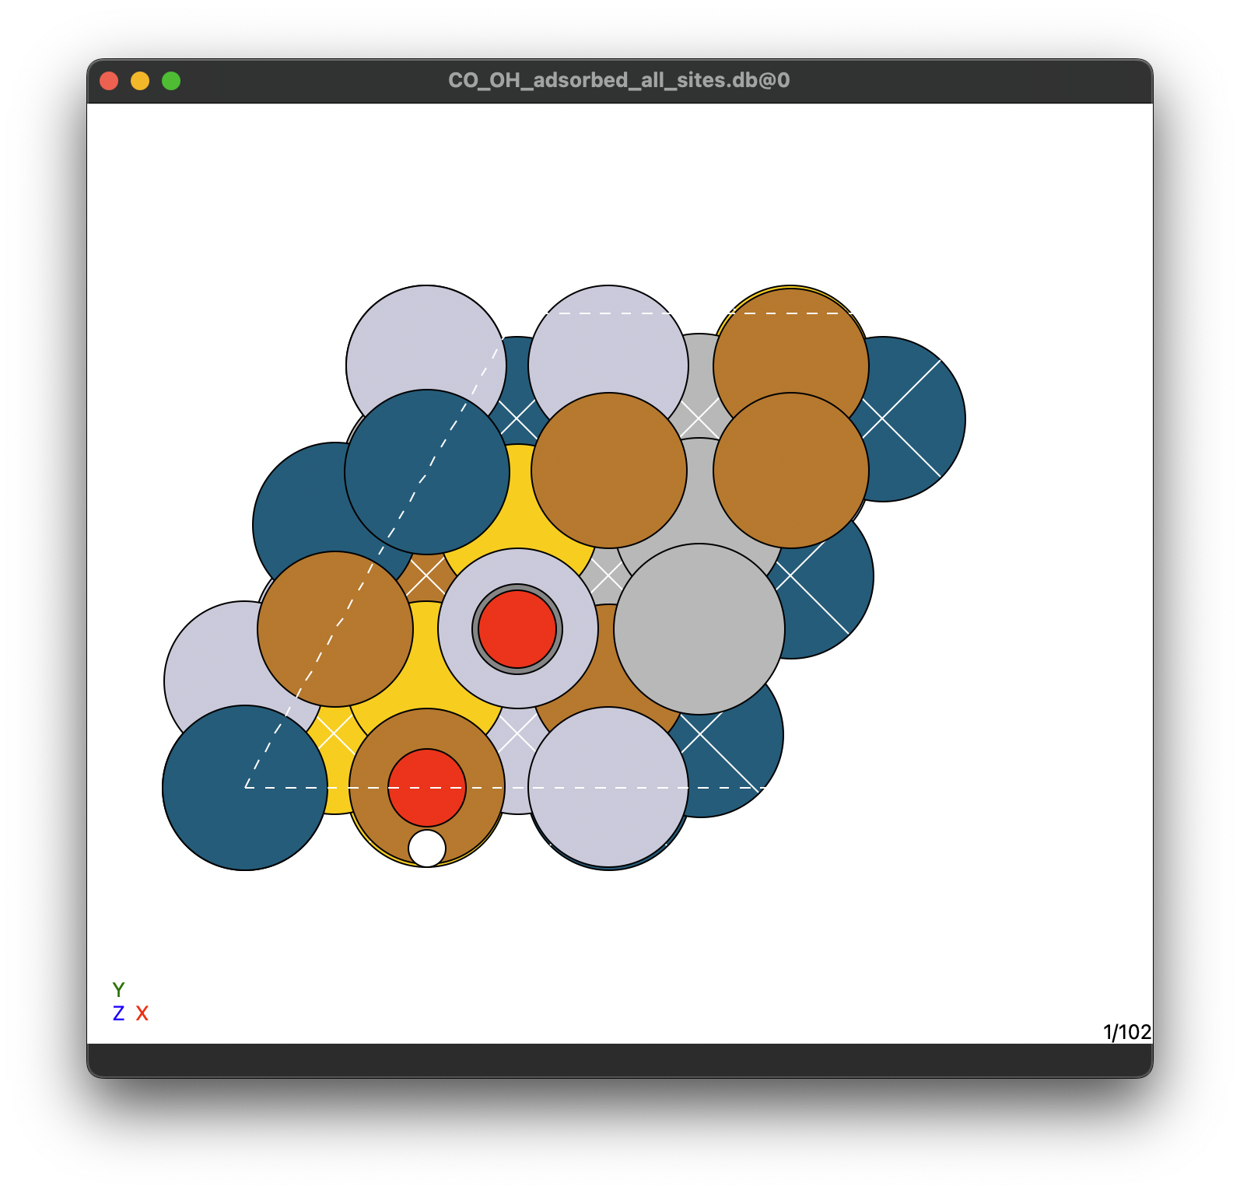
DFT data
*CO *OH best sites
*CO *OH all sites
100 HEA slabs
17 HEA slabs
5 pure metals
1 best site/slabs
6 sites/slabs
I accidentally put all 5 in there twice
100 total
102 total

Slide 9
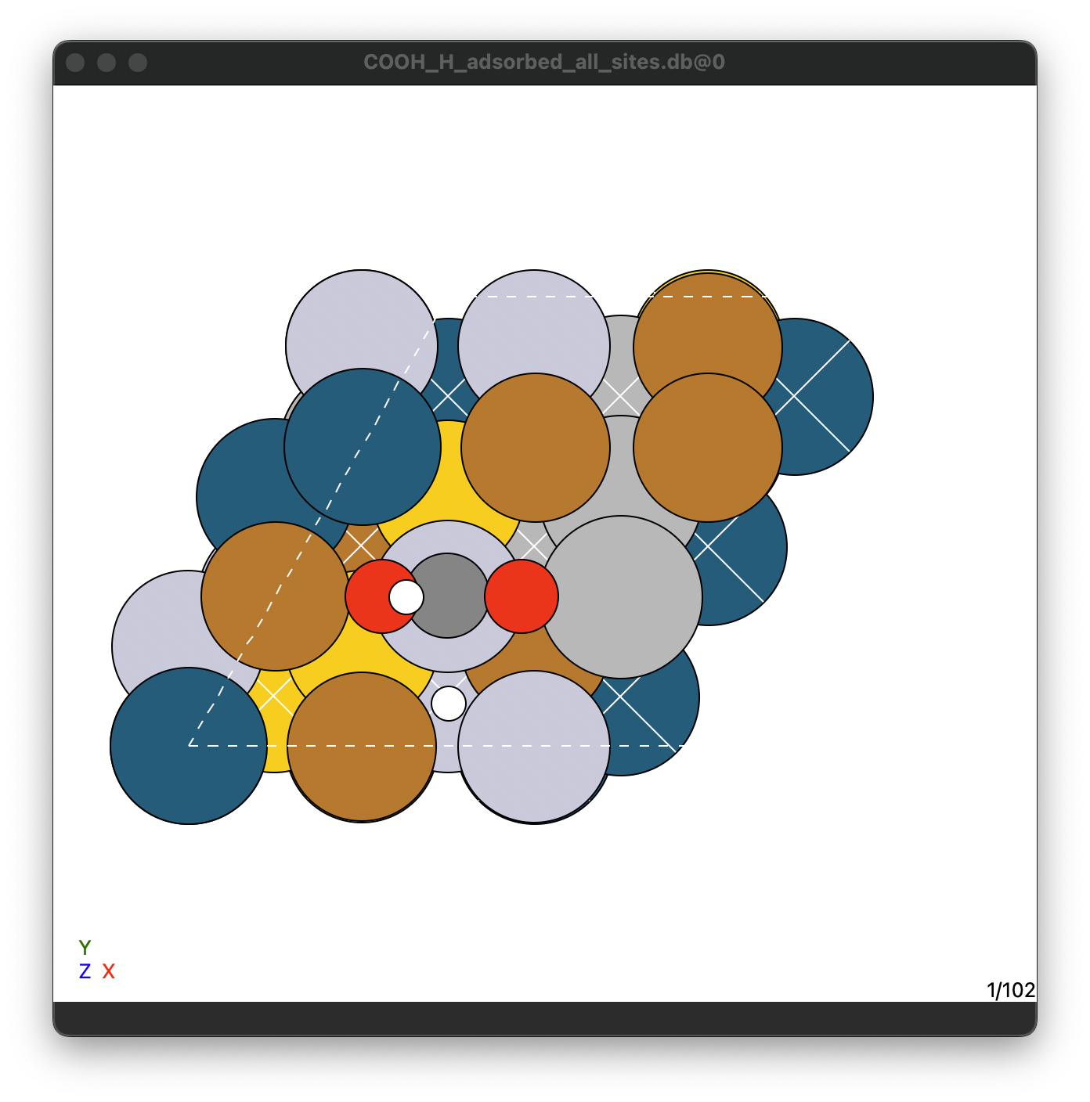
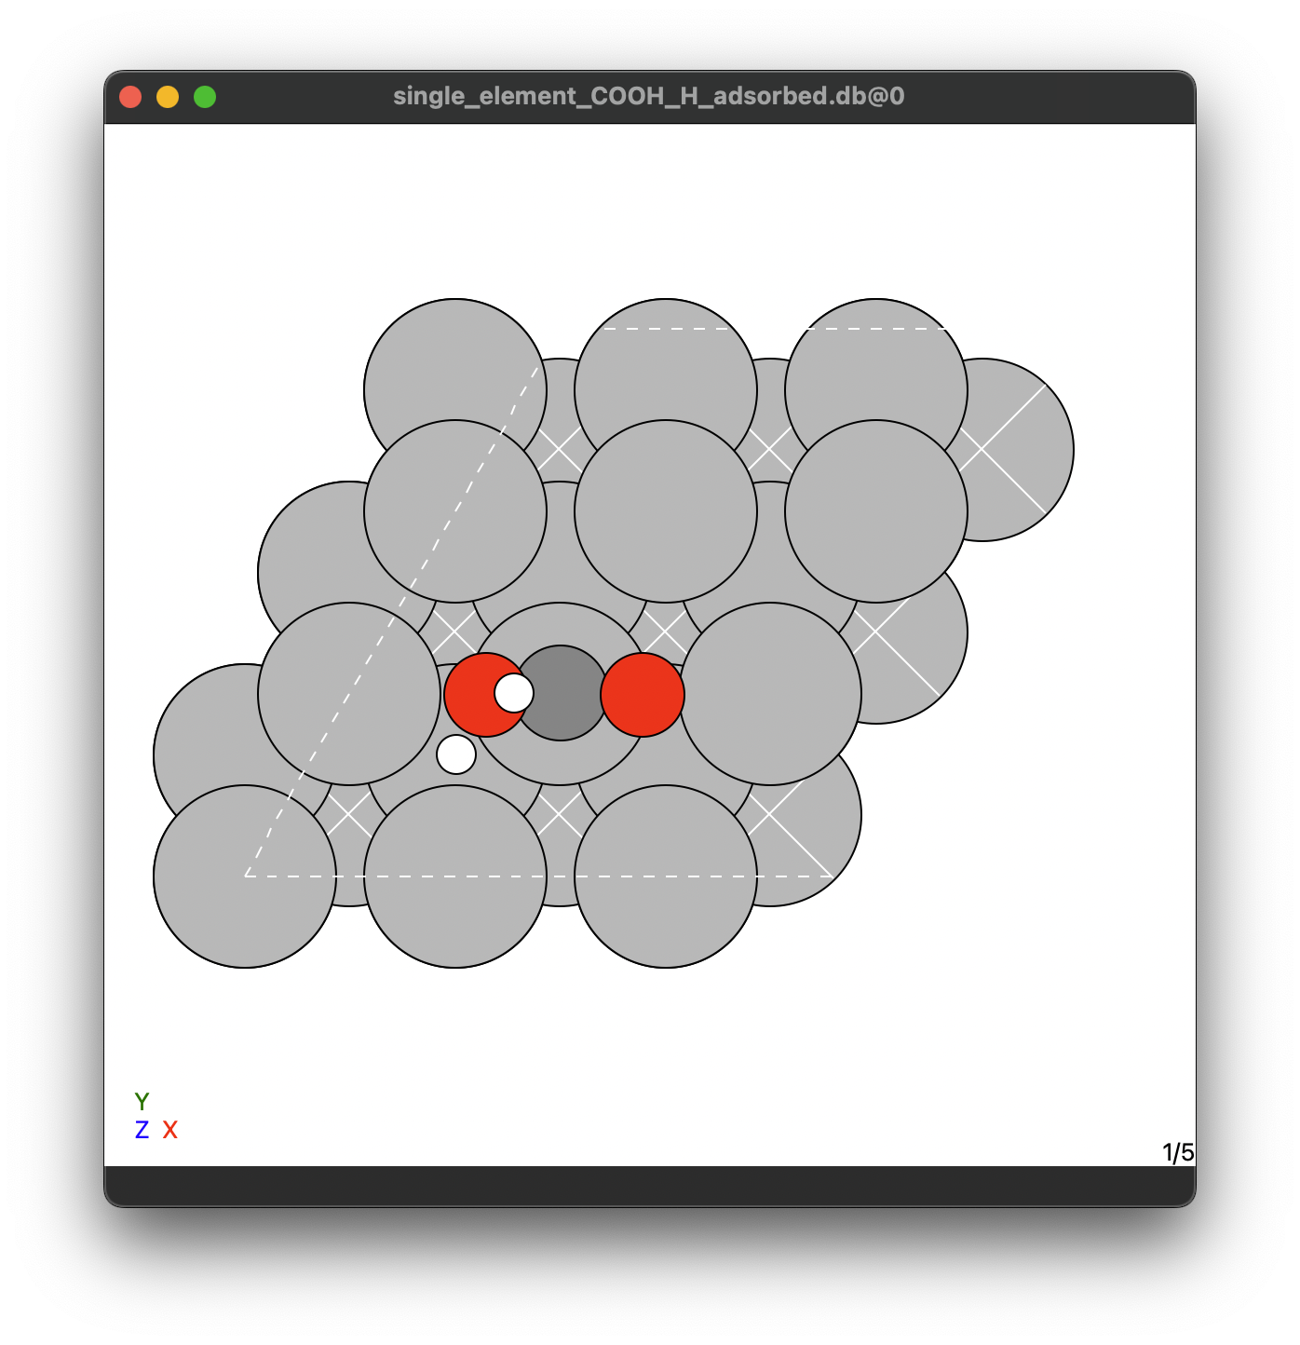
DFT data
COOH and H on all sites
17 HEA slabs
5 pure metals
6 sites/slab
102 total

Slide 10
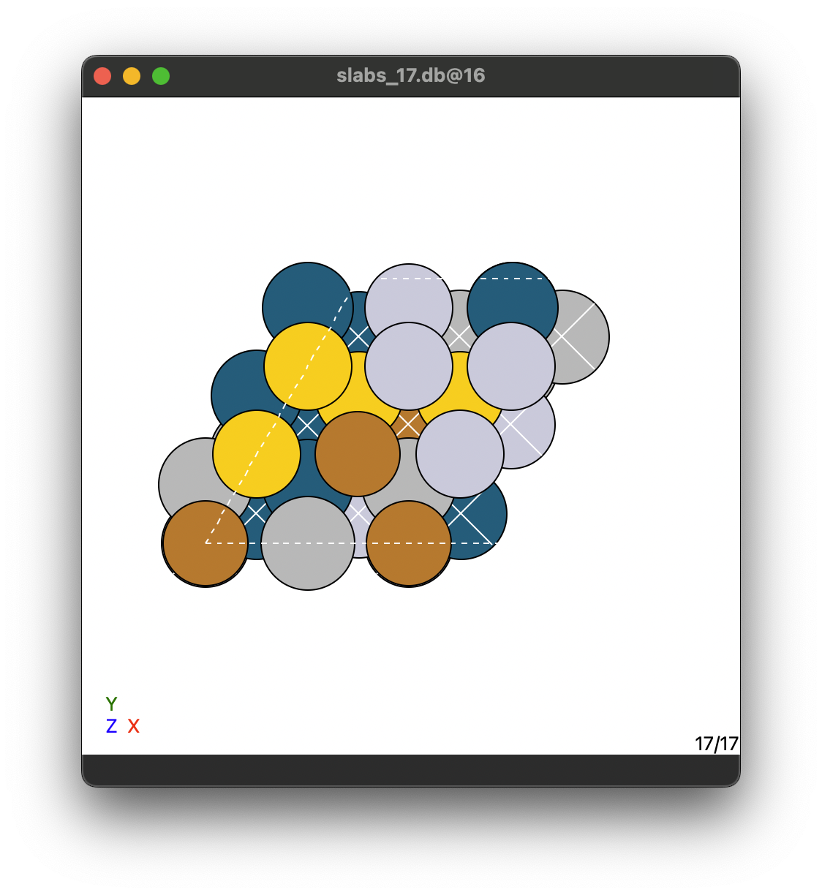
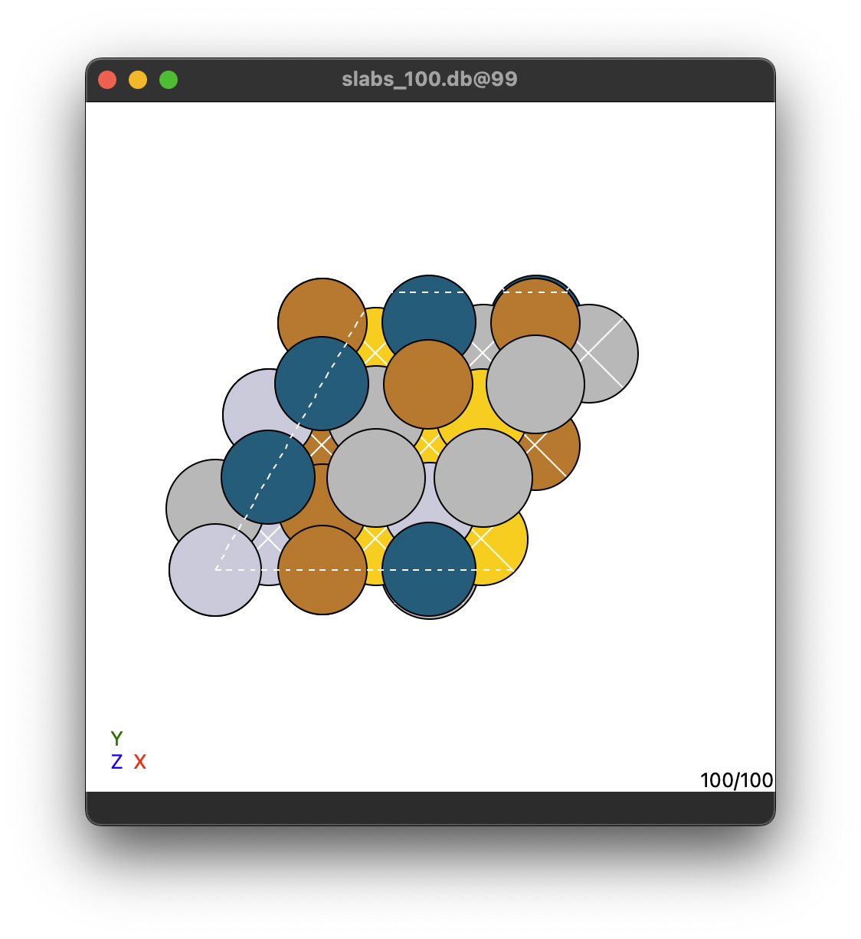
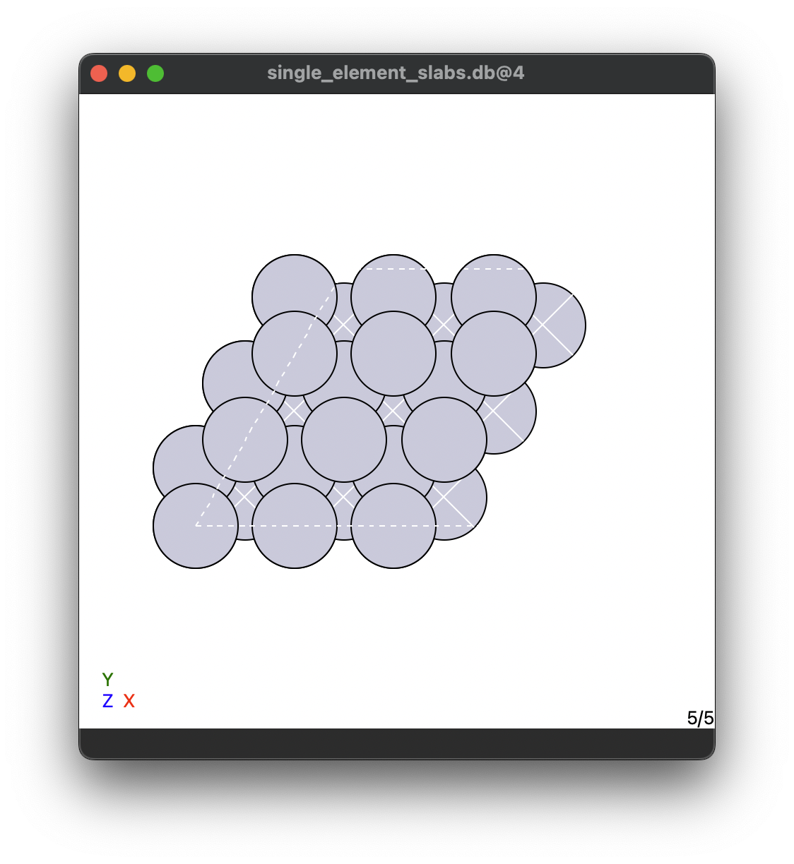
DFT data - slabs
Slabs for

Slide 11
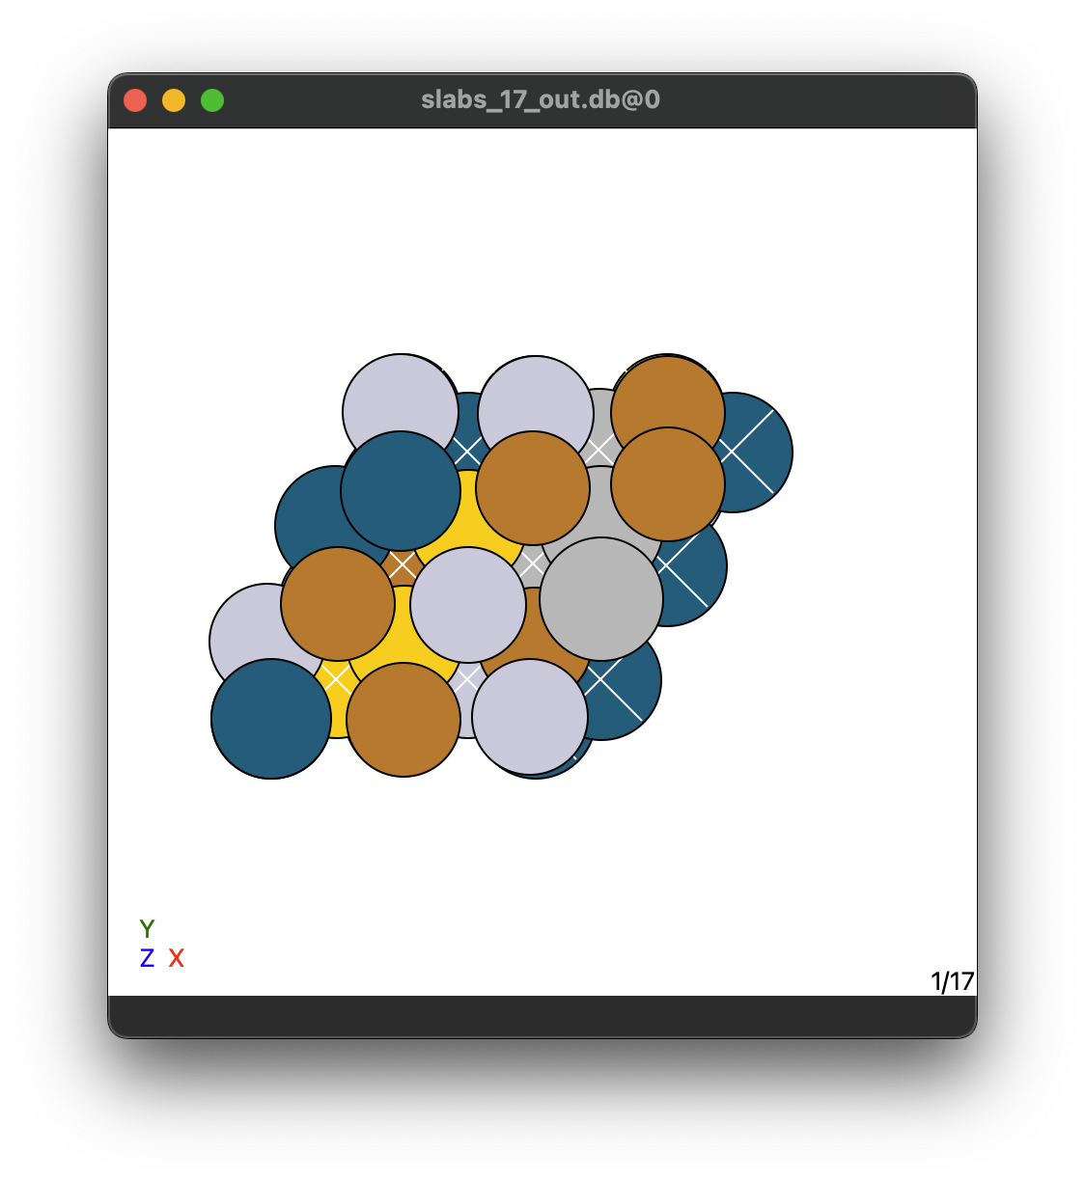
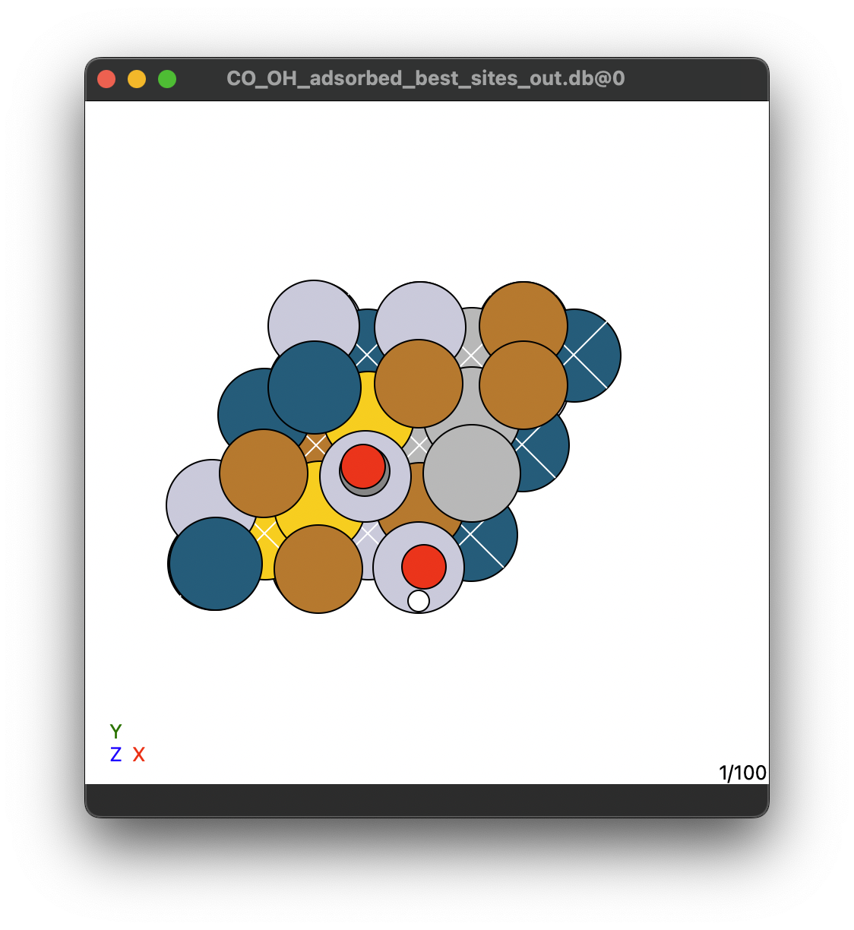
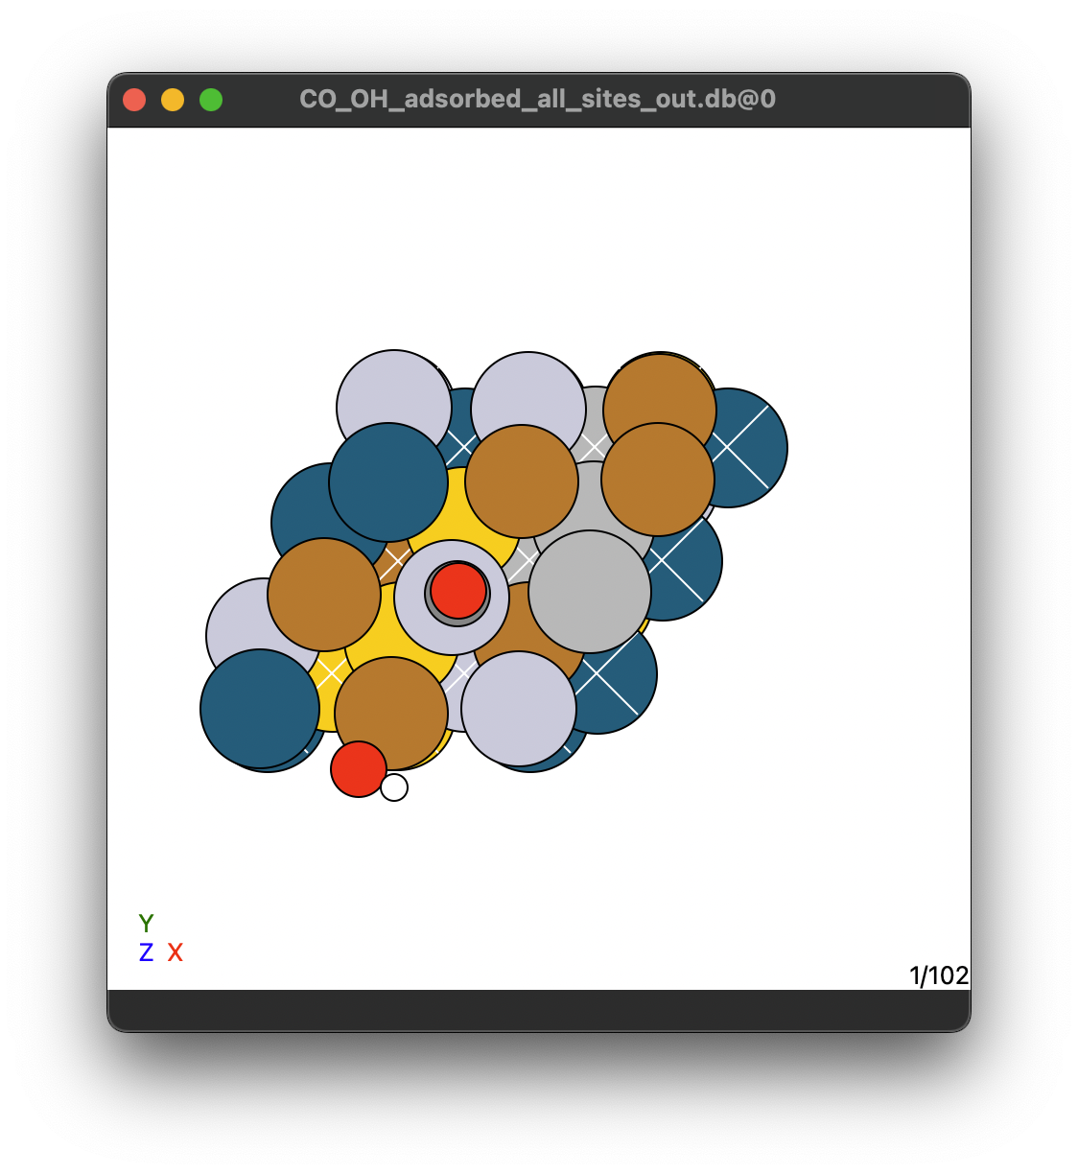
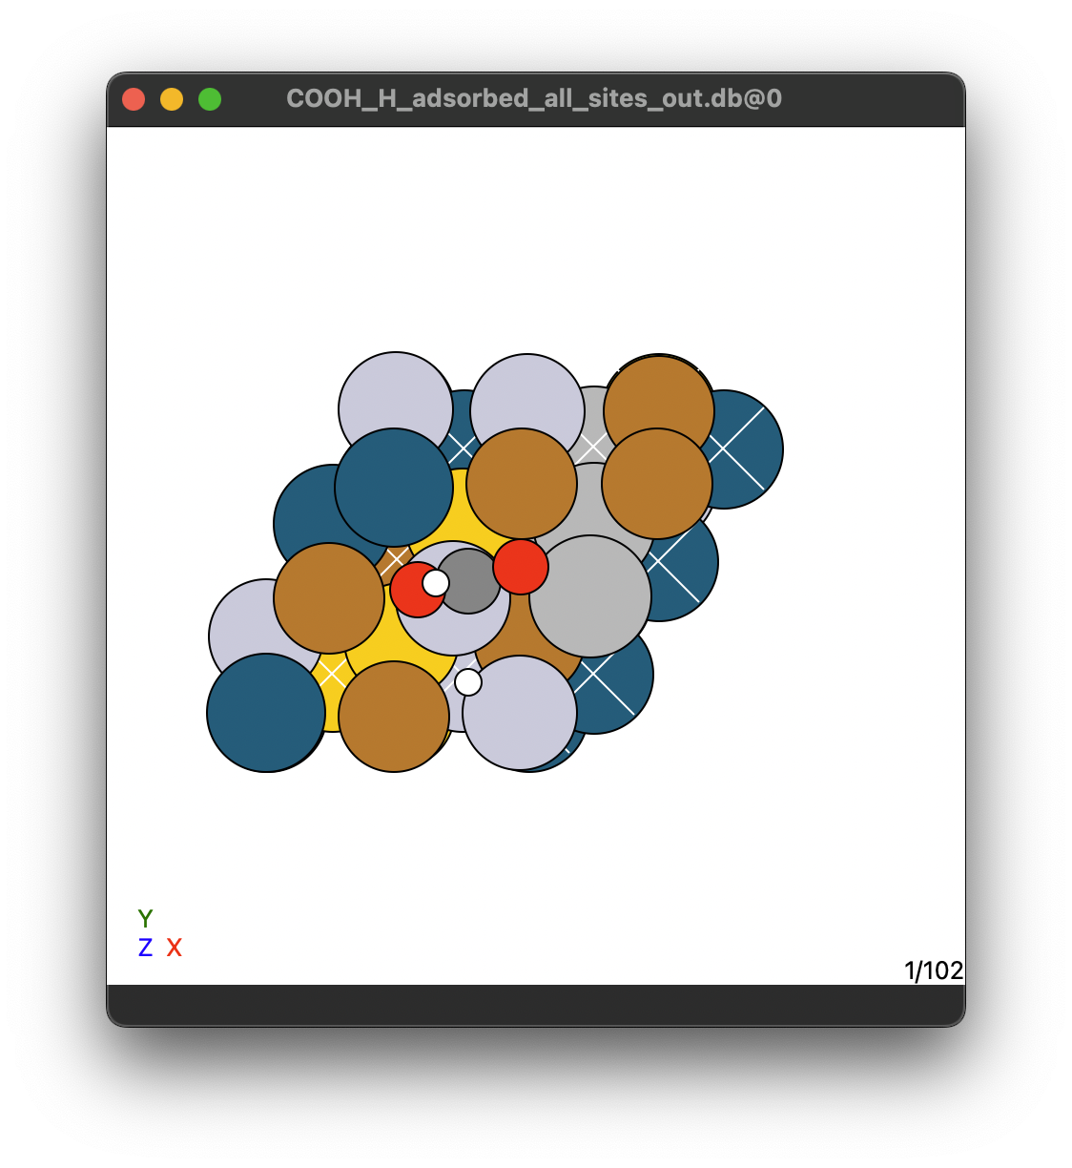
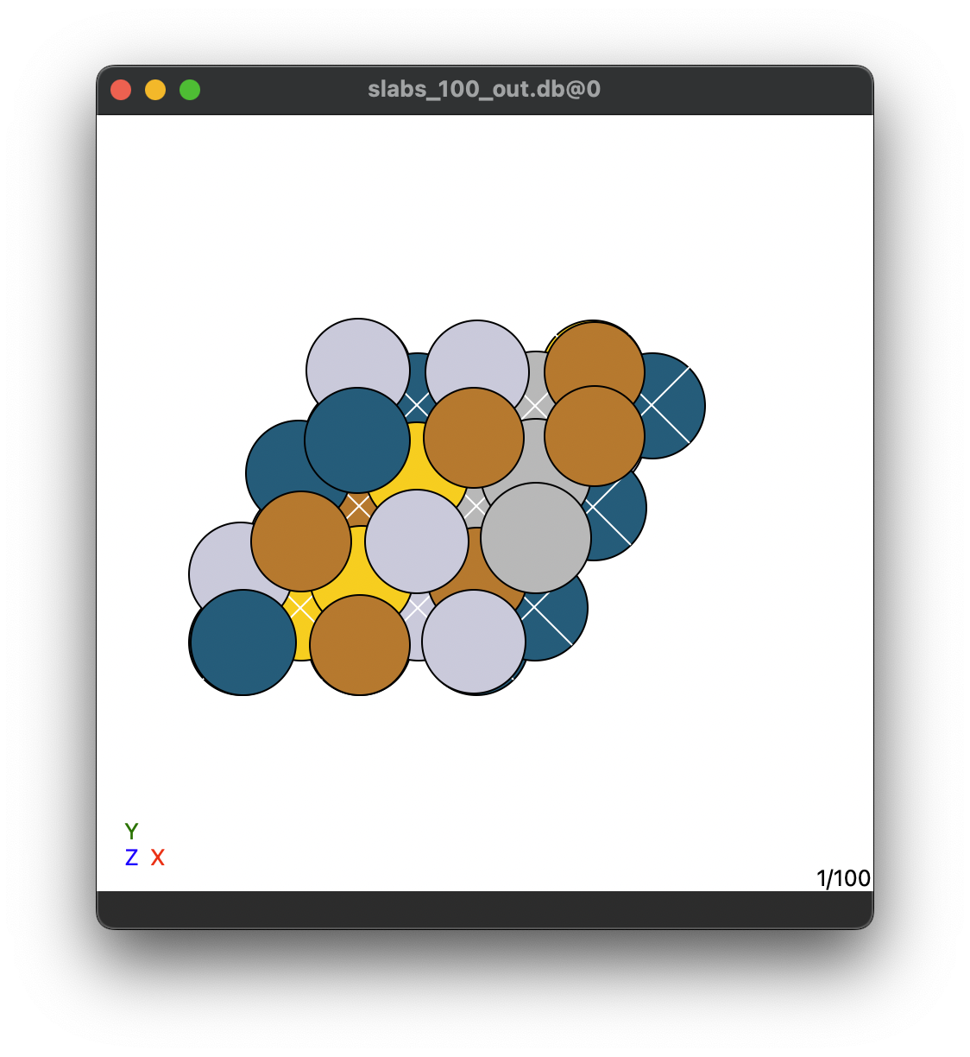
DFT calculations performed
Slabs
*CO *OH best sites
*CO *OH all sites
*COOH *H all sites
17 HEA slabs
On-top
On-top
On-top
On-top
Hollow-site
On-top
100 HEA slabs
17 HEA slabs
17 HEA slabs
1 best site/slabs
6 sites/slabs
6 sites/slabs
100 total
102 total
102 total
Slabs
100 HEA slabs

Slide 12
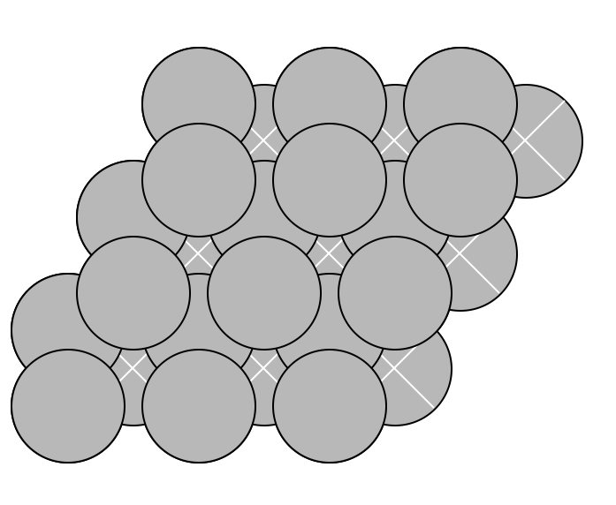
DFT calculations performed
*COOH + *H on all sites
*CO + *OH on all sites
*CO + *OH on best sites
Slabs
Slabs
Hollow-site
On-top
On-top
On-top
On-top
On-top
17 HEA slabs
6 sites/slabs
17 HEA slabs
6 sites/slabs
100 HEA slabs
1 best site/slabs
17 HEA slabs
5 pure metals
5 pure metals
5 pure metals
5 pure metals
100 HEA slabs

